Slide 1
Sprint Review
Getting to Know Shapefiles and GeoJSON

Slide 2
Getting to Know Shapefiles
Geographic Information Systems (GIS) anaylze and manipulate spatial data
Vector and raster data are the most common data formats for GIS
Shapefiles are the most common vector data format for GIS
Both the shapefile format and ArcGIS were developed by Esri

Slide 3
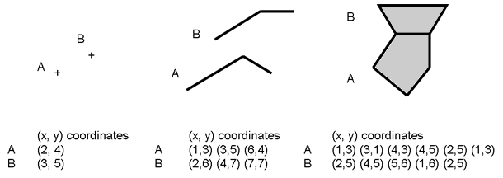
Getting to Know Shapefiles
Vector data uses points with lat/long coordinates, lines (pairs of points), and areas/polygons (groups of points) to represent discrete features and boundaries.
Shapefiles can support point, line, and area features.
http://www.restore.ac.uk/geo-refer/images/Concepts%20-%20geographical%20objects%20in%20GIS.png

Slide 4
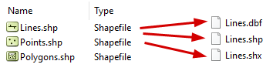
Getting to Know Shapefiles
An ESRI shapefile consists of multiple files stored in the same .shp directory
Shapefile (.shp) a binary file with vector feature geometry, each record describes a shape with a list of its vertices.
Shape index file (.shx.) used to search forward and backward
dBASE table (.dbf.) a database file storing feature IDs & attribute
The main shapefile, the index file, and the dBASE file must all have the same prefix.

Slide 5
Getting to Know Shapefiles
I explored the shapefile of the Statewide Agricultural Land Use Baseline 2015 Study
The zipped shapefile (2015AgBaseline.shp.zip) is 11.8 mb,
Ufolder (2015AgBaseline.shp) is 19 mb.
Within the unzipped file are the 3 mandatory files:
2015AgBaseline.shp the shapefile containing the geospatial features
2015AgBaseline.shx
2015AgBaseline.dbf the database file containing attributes that can be associated with the shapefile

Slide 6
Getting to Know Shapefiles
Within the unzipped file are also 8 other files:
2015AgBaseline.CPG an optional plain text file describing the encoding used to create the shapefile
2015AgBaseline.lyr is a visual representation of a layer
2015AgBaseline.prj which is the layer projection data
2015AgBaseline.sbx an optional spatial index file that helps speed things up
2015AgBaseline.sbn optimize spatial queries in tandem with .sbx
2015AgBaseline.shp.xml which is an xml version of the entire metadata
2015AgBaseline_Protocols.pdf which explains the research protocols
aglanduse_2015.pdf which is the metadata file explaining the shapefile

Slide 7
Getting to Know GeoJSON
JSON is a "lightweight, text-based,language-independent data interchange format" (JSON spec). JSON structures data following a set formatting rules.
GeoJSON is a "geospatial data interchange format based on JSON" and it defines several types of JSON objects and the manner in which they are combined to represent data about geographic features, their properties, and their spatial extents" (GeoJSON Spec).

Slide 8
Getting to Know GeoJSON
GeoJSON uses the World Geodetic System 1984 (WGS 84) geographic coordinate reference system (CRS)
Latitute and longitude are represented in decimal degrees
as opposed to degrees ° , minutes, and seconds
Lat and long are ordered differently in different file types
Both GeoJSON and Shapefiles use the order: long lat
GeoJSON has 7 different "geometry types
"Point", "MultiPoint", "LineString", "MultiLineString", "Polygon", "MultiPolygon", and "GeometryCollection".

Slide 9
Attempting to Convert a Shapefile to GeoJSON
Tried a few different online tools to convert .shp to .geojson

Slide 10
Attempting to Convert a Shapefile to GeoJSON
Mapshaper
Mapshaper quickly uploaded my data
Upon upload it showed the polygons of the entire dataset and could be zoomed into and around
There are a few export options
I exported as GeoJSON file, 2015AgBaseline.json and 41.3 mb in size
MyGeodata Converter
MyGeodata Converter uploaded my data fairly quickly.
Handily it has a viewer with a bounding box of the spatial extent the file overlaid a basemap
Unhandily it has a paywall and would only export a sample of the file
The file downloaded as mygeodata.zio and unzipped to 2015AgBaseline.geojson, but due to the trimming was only 214 kb
ogr2ogr web client
User must check the 'force download' button or the entire JSON output will load in the broswer window.
File downloaded as convert.json and 38.5 mb in size
different online tools to convert .shp to .geojson

Slide 11
Attempting to Convert a Shapefile to GeoJSON
MyGeodata Converter
MyGeodata Converter uploaded my data fairly quickly.
Handily it has a viewer with a bounding box of the spatial extent the file overlaid a basemap
Unhandily it has a paywall and would only export a sample of the file
The file downloaded as mygeodata.zio and unzipped to 2015AgBaseline.geojson, but due to the trimming was only 214 kb

Slide 12
Attempting to Convert a Shapefile to GeoJSON
ogr2ogr web client
User must check the 'force download' button or the entire JSON output will load in the broswer window.
File downloaded as convert.json and 38.5 mb in size

Slide 13
In Summary
Shapefiles are a package of files, the primary of which (.shp, .shx) are stored in binary
JSON files on the other hand are human-readable (ASCII)

Slide 14
Pau

